Slide 1
The Trifocal Tensor
Class 17
Multiple View Geometry
Comp 290-089
Marc Pollefeys

Slide 2
Content
Background: Projective geometry (2D, 3D), Parameter estimation, Algorithm evaluation.
Single View: Camera model, Calibration, Single View Geometry.
Two Views: Epipolar Geometry, 3D reconstruction, Computing F, Computing structure, Plane and homographies.
Three Views: Trifocal Tensor, Computing T.
More Views: N-Linearities, Multiple view reconstruction, Bundle adjustment, auto-calibration, Dynamic SfM, Cheirality, Duality

Slide 3
Multiple View Geometry course schedule
(subject to change)
Jan. 7, 9 | Intro & motivation | Projective 2D Geometry
Jan. 14, 16 | (no class) | Projective 2D Geometry
Jan. 21, 23 | Projective 3D Geometry | (no class)
Jan. 28, 30 | Parameter Estimation | Parameter Estimation
Feb. 4, 6 | Algorithm Evaluation | Camera Models
Feb. 11, 13 | Camera Calibration | Single View Geometry
Feb. 18, 20 | Epipolar Geometry | 3D reconstruction
Feb. 25, 27 | Fund. Matrix Comp. | Fund. Matrix Comp.
Mar. 4, 6 | Rect. & Structure Comp. | Planes & Homographies
Mar. 18, 20 | Trifocal Tensor | Three View Reconstruction
Mar. 25, 27 | Multiple View Geometry | MultipleView Reconstruction
Apr. 1, 3 | Bundle adjustment | Papers
Apr. 8, 10 | Auto-Calibration | Papers
Apr. 15, 17 | Dynamic SfM | Papers
Apr. 22, 24 | Cheirality | Project Demos

Slide 4

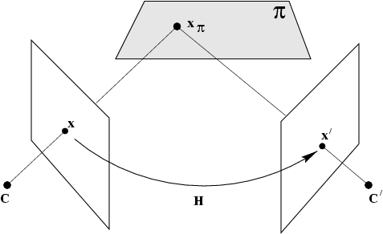



Scene planes and homographies
plane induces homography between two views

Slide 5
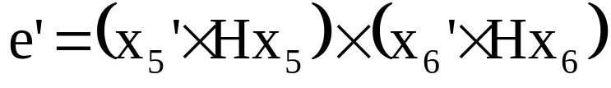
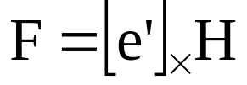
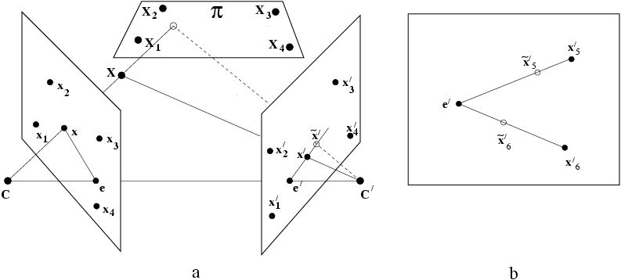
6-point algorithm
x₁,x₂,x₃,x₄ in plane, x₅,x₆ out of plane
Compute H from x₁,x₂,x₃,x₄

Slide 6

Three-view geometry

Slide 7
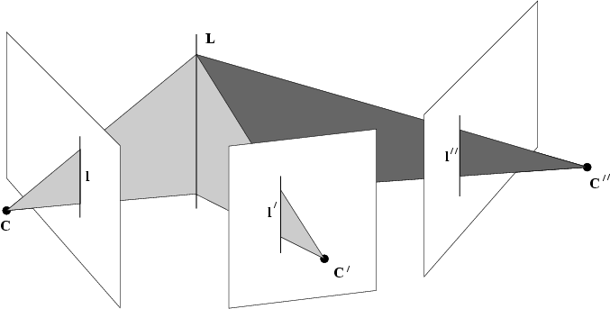
The trifocal tensor
Three back-projected lines have to meet in a single line
Incidence relation provides constraint on lines
Let us derive the corresponding algebraic constraint…

Slide 8
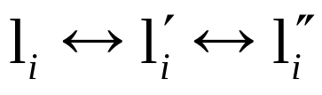

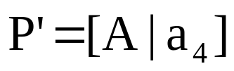
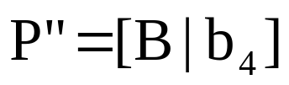
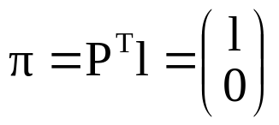
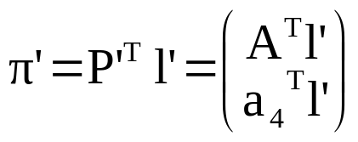
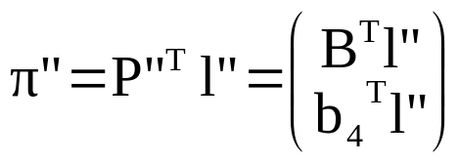
Notations

Slide 9

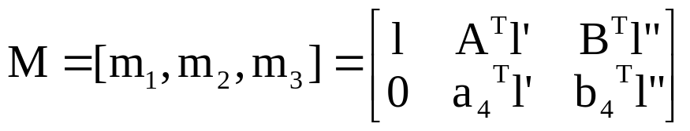


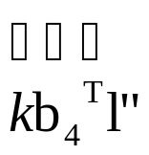
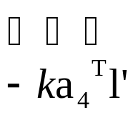

Incidence
e.g. π is part of bundle formed by π’ and π”

Slide 10




Incidence relation

Slide 11




The Trifocal Tensor
Trifocal Tensor = {T₁,T₂,T₃}
Only depends on image coordinates and is thus independent of 3D projective basis
Also and but no simple relation
General expression not as simple as
DOF T: 3x3x3=27 elements, 26 up to scale
3-view relations: 11x3-15=18 dof
8(=26-18) independent algebraic constraints on T
(compare to 1 for F, i.e. rank-2)

Slide 12
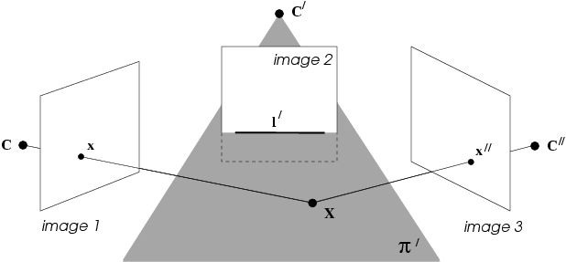
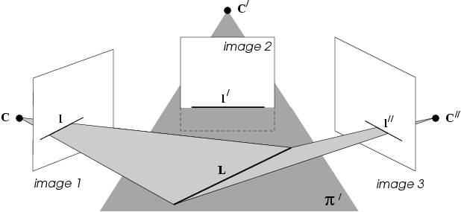


Slide 13








Homographies induced by a plane

Slide 14




Line-line-line relation
(up to scale)
Eliminate scale factor:

Slide 15
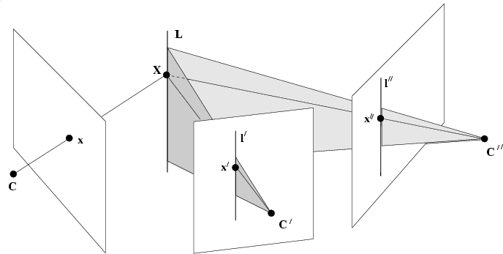


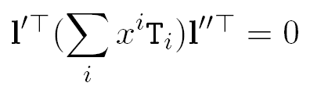


Point-line-line relation

Slide 16
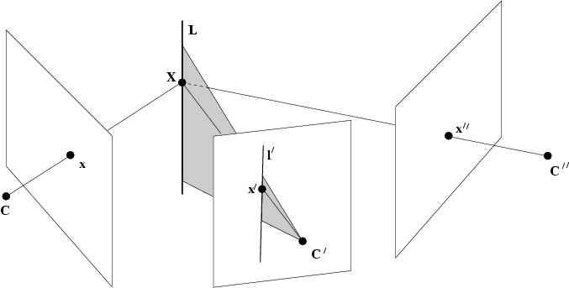
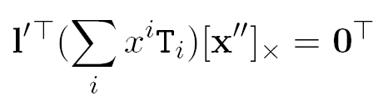
Point-line-point relation
note: valid for any line through x”, e.g. l”=[x”]_{x}x”_{arbitrary}

Slide 17
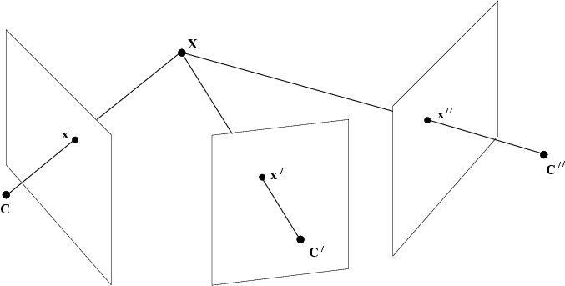
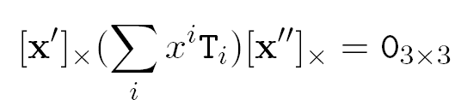
Point-point-point relation
note: valid for any line through x’, e.g. l’=[x’]_{x}x’_{arbitrary}

Slide 18
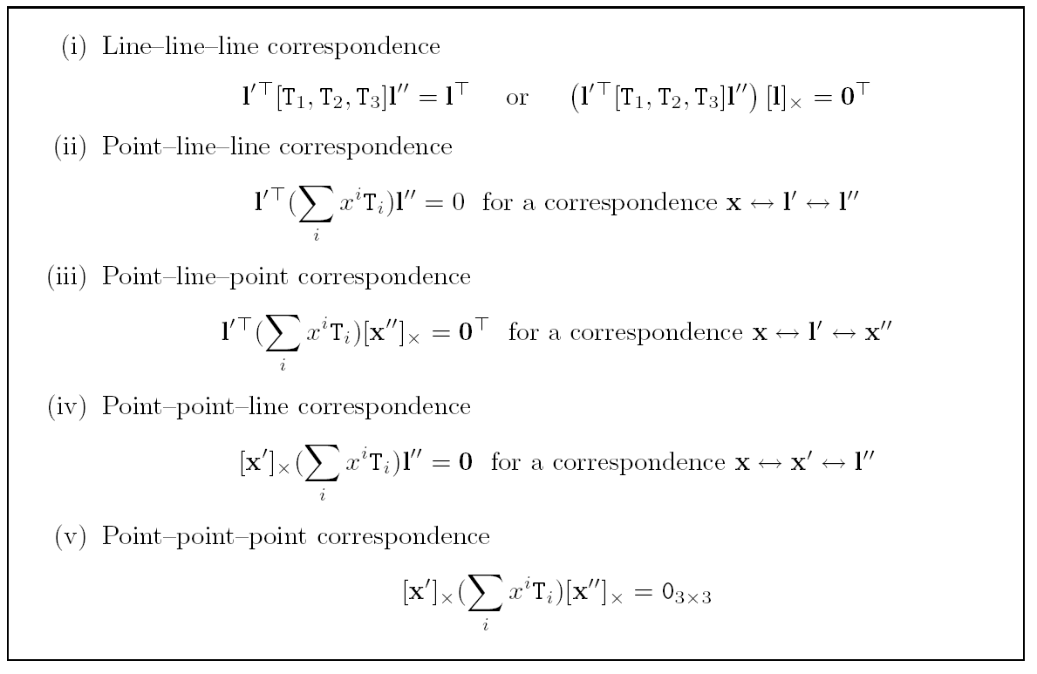
Overview incidence relations

Slide 19
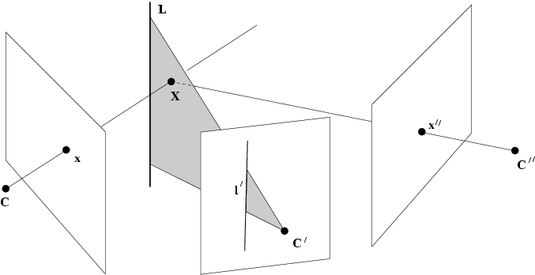
Non-incident configuration
incidence in image does not guarantee incidence in space

Slide 20
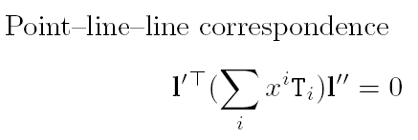
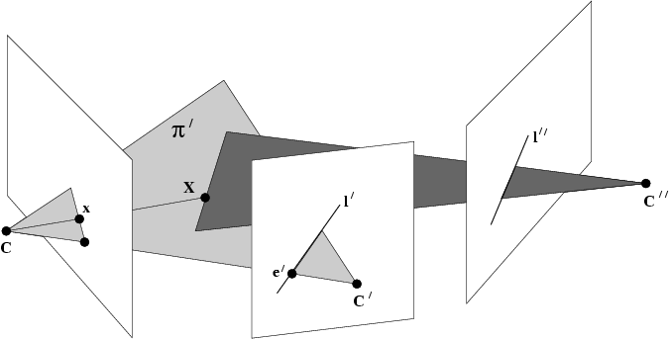
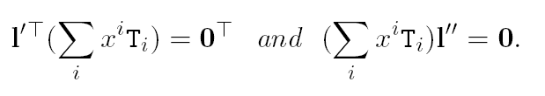
Epipolar lines
if l’ is epipolar line, then satisfied for arbitrary l”
inversely,
epipolar lines are right and left null-space of

Slide 21


Epipoles
With points
becomes respectively
Epipoles are intersection of right resp. left null-space of
(e=P’C and e”=P”C)

Slide 22
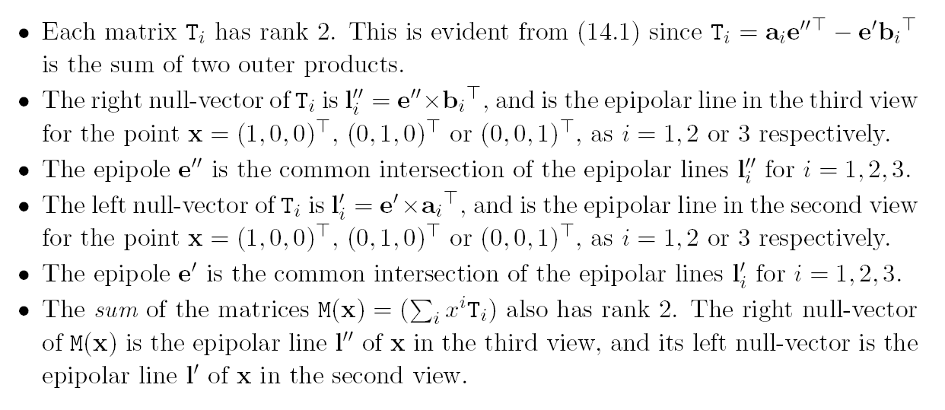
Algebraic properties of T_{i} matrices

Slide 23
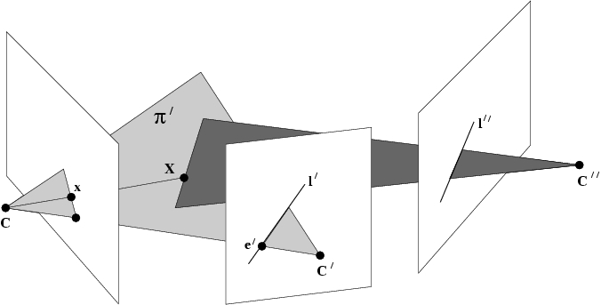






Extracting F
good choice for l” is e” (V₃^{T}e”=0)

Slide 24








Computing P,P‘,P“
?
ok, but not
specifically, (no derivation)

Slide 25


matrix notation is impractical
Use tensor notation instead

Slide 26
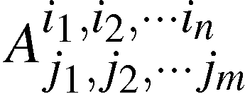
Definition affine tensor
Collection of numbers, related to coordinate choice, indexed by one or more indices
Valency = (n+m)
Indices can be any value between 1 and the dimension of space (d^{(n+m)} coefficients)

Slide 27
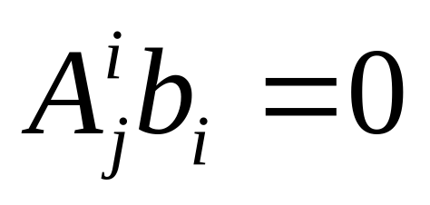
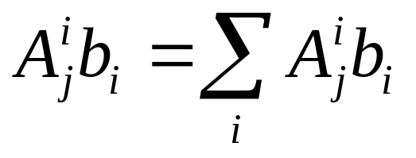
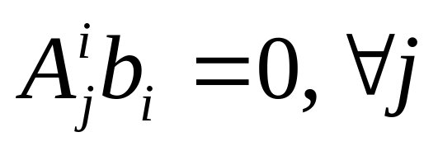
Conventions
Einstein’s summation:
(once above, once below)
Index rule:

Slide 28
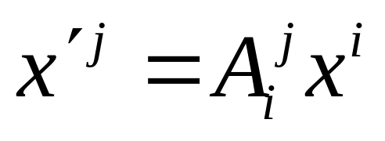
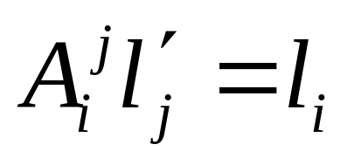
More on tensors
Transformations
(covariant)
(contravariant)

Slide 29
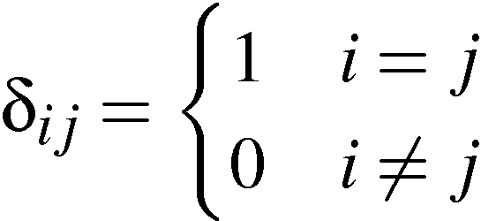
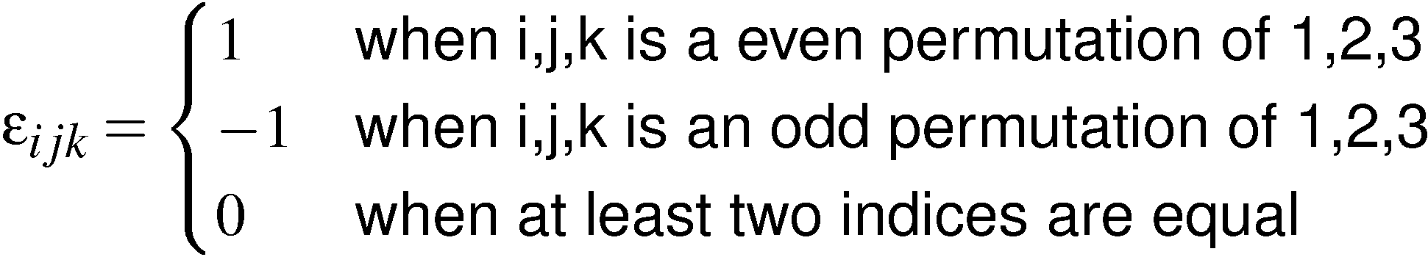
Some special tensors
Kronecker delta
Levi-Cevita epsilon
(valency 2 tensor)
(valency 3 tensor)

Slide 30
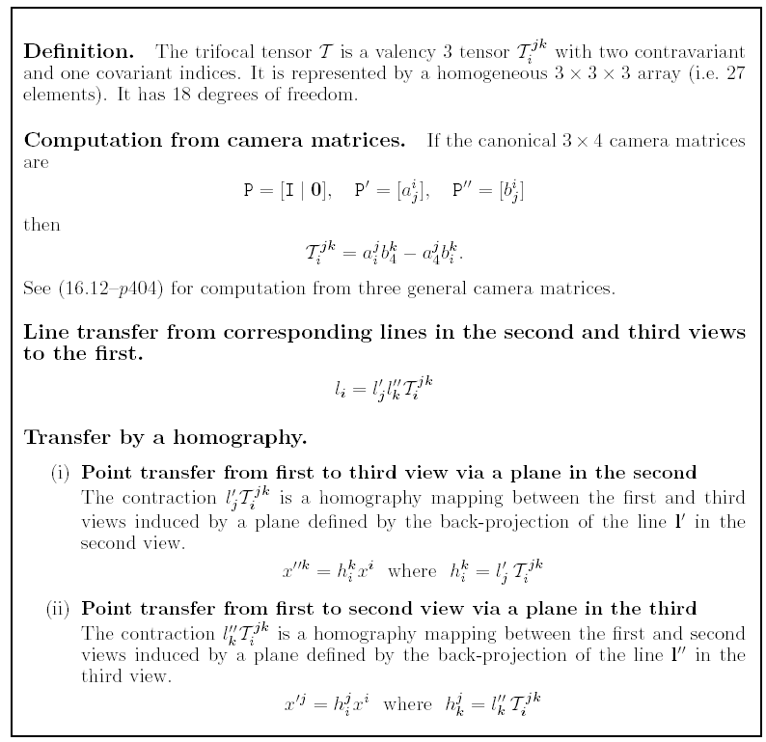

Slide 31
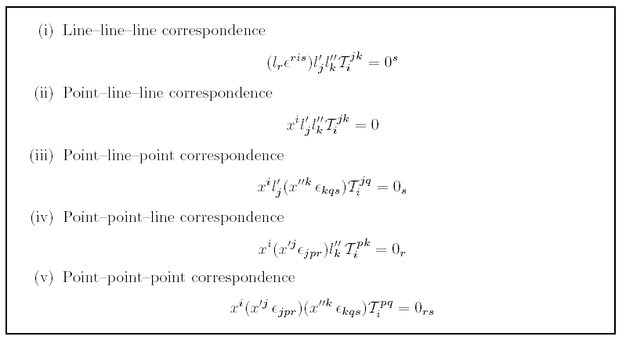
Trilinearities

Slide 32
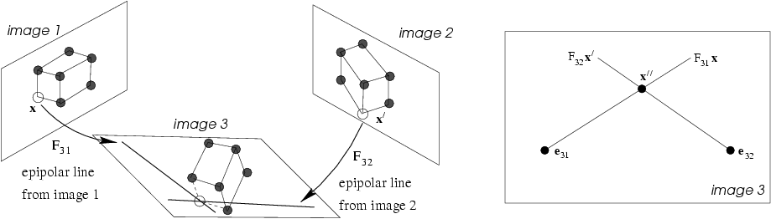

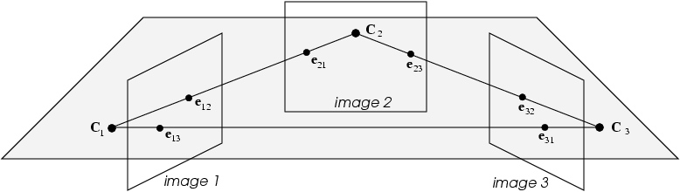
Transfer: epipolar transfer

Slide 33

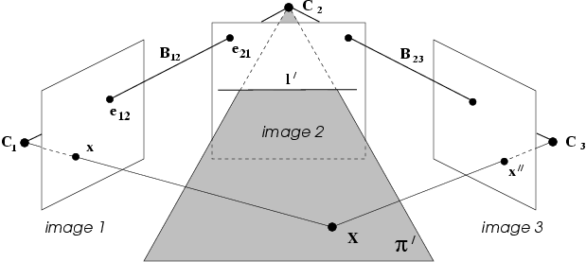
Transfer: trifocal transfer
Avoid l’=epipolar line

Slide 34
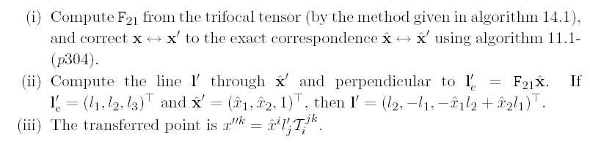

Transfer: trifocal transfer
point transfer
line transfer
degenerate when known lines
are corresponding epipolar lines

Slide 35
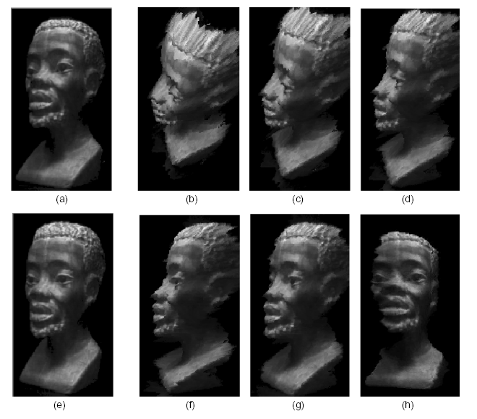
Image warping using T(1,2,N)
(Avidan and Shashua `97)

Slide 36
Next class:
Computing Three-View Geometry
building block for structure and motion computation

